Slide 1
WEEK 5: Input/Output Streams – Byte Streams , Character Streams
Objective: To perform file operations using byte-oriented I/O streams and character oriented I/O Streams

Slide 2
Difference between byte and character stream
Reading and writing binary files
FileInputStream
FileOutputStream
Reading and writing text files
FileReader
FileWriter

Slide 3
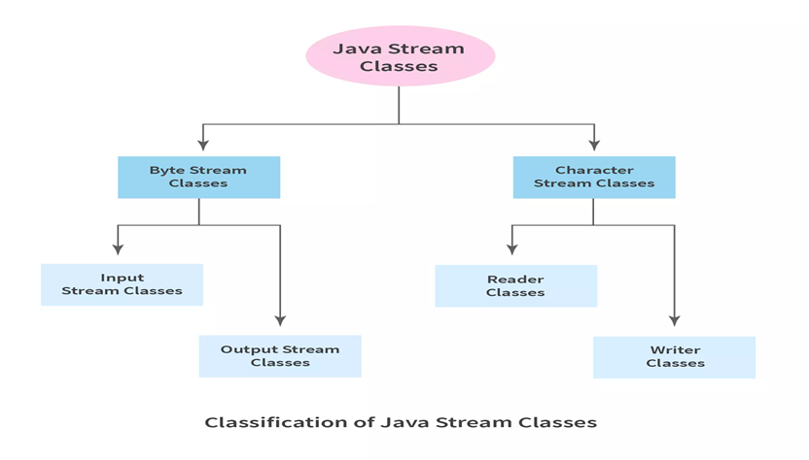
Byte stream Vs Character stream

Slide 4
Byte stream Vs Character stream
Aspect | Byte Stream | Character Stream
Data handled | Raw bytes (8-bit) | Characters (16-bit Unicode)
Used for | Binary data (images, audio, video, PDFs) | Text data (files with characters)
Base classes | InputStream, OutputStream | Reader, Writer
Encoding support | ❌ No automatic encoding | ✅ Handles character encoding
Speed | Faster for binary data | Safer for text processing
Example unit | Reads/writes 1 byte at a time | Reads/writes 1 character at a time

Slide 5
Byte stream
Byte Stream (InputStream / OutputStream)
✔ Used when data is not text
✔ Byte streams handle raw binary data and are suitable for images, audio, and other non-text files.
Common Classes
FileInputStream
FileOutputStream
BufferedInputStream
BufferedOutputStream

Slide 6
FileInputStream
FileInputStream fis = new FileInputStream("image.jpg");
int b;
while ((b = fis.read()) != -1) {
System.out.print(b);
}
fis.close();
FileOutputStream
FileOutputStream fos = new FileOutputStream("data.bin");
fos.write(65); // writes byte value
fos.close();

Slide 7
import java.io.FileOutputStream;
import java.io.IOException;
public class FileOutputExample {
public static void main(String[] args) {
try {
FileOutputStream fos = new FileOutputStream("output.txt");
String msg = "Hello Java";
byte[] data = msg.getBytes(); // convert String to bytes
fos.write(data); // write bytes to file
fos.close(); // close the stream
System.out.println("Data written successfully");
} catch (IOException e) {
e.printStackTrace();
}
}
}

Slide 8
import java.io.FileInputStream;
import java.io.FileOutputStream;
import java.io.IOException;
public class iostexample { // Class name should start with a capital letter
public static void main(String[] args) {
try (
FileInputStream fis = new FileInputStream(
"C:\\Users\\MAHE\\Desktop\\AS.jpg");
FileOutputStream fos = new FileOutputStream(
"C:\\Users\\MAHE\\Desktop\\Temp\\destination.jpg")
) {
int b;
while ((b = fis.read()) != -1) {
fos.write(b);
}
System.out.println("Image copied successfully");
} catch (IOException e) {
e.printStackTrace();
}
}
}

Slide 9
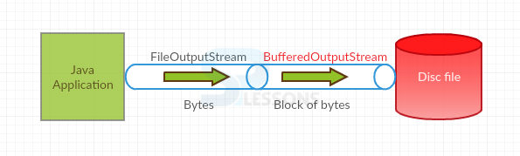
BufferedInputStream and BufferedOutputStream
What is Buffering?
Buffering means using a temporary memory area (buffer) to store data before actual I/O happens.
Instead of reading/writing one byte at a time from disk:
Reads a block of bytes into memory
Performs faster operations

Slide 10
BufferedInputStream and BufferedOutputStream
BufferedInputStream
✔ What it does
Reads data from a buffer, not directly from the file
Wraps around another input stream
FileInputStream fis = new FileInputStream("image.jpg");
BufferedInputStream bis = new BufferedInputStream(fis);
int b;
while ((b = bis.read()) != -1) {
System.out.print(b);
}
bis.close();

Slide 11
BufferedInputStream and BufferedOutputStream
BufferedOutputStream
✔ What it does
Writes data to a buffer first
Actual file write happens when:
  Buffer is full
  flush() is called
  Stream is closed
FileOutputStream fos = new FileOutputStream("copy.jpg");
BufferedOutputStream bos = new BufferedOutputStream(fos);
bos.write(65); // written to buffer
bos.flush(); // forces data to file
bos.close();

Slide 12
import java.io.*;
public class iostexample {
public static void main(String[] args) throws IOException {
try (
BufferedInputStream bis = new BufferedInputStream( new FileInputStream("C:\\Users\\MAHE\\Desktop\\AS.jpg"));
BufferedOutputStream bos = new BufferedOutputStream(new FileOutputStream("C:\\Users\\MAHE\\Desktop\\dest.jpg"))
)
{
int b;
while ((b = bis.read()) != -1) {
bos.write(b);
}
}
System.out.println("Image copied using buffered streams");
}
}

Slide 13
Character Streams
Character Stream (Reader / Writer)
✔ Used when working with text
Common Classes
FileReader
FileWriter
BufferedReader
BufferedWriter

Slide 14
Character Streams
FileWriter
FileReader
FileWriter is a character stream class used to write text (characters) to a file.
It is Unicode-aware, so it’s suitable for text files.
Reads characters, not bytes
Best for text files (.txt, .csv, source code)
Uses default character encoding
FileWriter fw = new FileWriter("data.txt", true);
fw.write("\nThis line is appended");
fw.close();
FileReader fr = new FileReader("data.txt");
int ch;
while ((ch = fr.read()) != -1) {
System.out.print((char) ch);
}
fr.close();

Slide 15
Character Streams
import java.io.FileReader;
import java.io.IOException;
public class filsampl {
public static void main(String[] args) throws IOException {
FileReader fr = new FileReader("C:\\Users\\MAHE\\Desktop\\sampl.txt");
int ch;
while ((ch = fr.read()) != -1) {
System.out.print((char) ch);
}
fr.close();
}
}

Slide 16
Character Streams
BufferedReader
✔ What it does
Reads blocks of characters into memory
Wraps a FileReader
Can read line by line
BufferedReader
BufferedReader br = new BufferedReader(new FileReader("data.txt"));
String line;
while ((line = br.readLine()) != null) {
System.out.println(line);
}
br.close();

Slide 17
Character Streams
BufferedWriter
✔ What it does
Writes characters to a buffer first
Disk write happens when:
  Buffer is full
  flush() is called
  Stream is closed
BufferedWriter bw = new BufferedWriter(new FileWriter("data.txt"));
bw.write("Hello Java");
bw.newLine();
bw.flush();
bw.close();

Slide 18
Copying from one text file to another text file
int ch;
while ((ch = fr.read()) != -1) {
fw.write(ch);
}
System.out.println("File copied successfully.");
} catch (IOException e) {
e.printStackTrace();
} }
}
import java.io.FileReader;
import java.io.FileWriter;
import java.io.IOException;
public class sampl12 {
public static void main(String[] args) {
FileReader fr = null;
FileWriter fw = null;
try {
fr = new FileReader("C:\\Users\\MAHE\\Desktop\\sampl.txt"); // source file
fw = new FileWriter("C:\\Users\\MAHE\\Desktop\\dest.txt"); // destination file

Slide 19
Writing multiple text files into a single file
import java.io.*;
public class multfile {
public static void main(String[] args) {
// List of input files
String[] inputFiles = {
"C:\\Users\\MAHE\\Desktop\\sampl.txt",
"C:\\Users\\MAHE\\Desktop\\T1.txt",
"C:\\Users\\MAHE\\Desktop\\t2.txt"
};
String outputFile = "C:\\Users\\MAHE\\Desktop\\merged.txt";
try (BufferedWriter bw = new BufferedWriter(new FileWriter(outputFile))) {
for (String file : inputFiles) {
try (BufferedReader br = new BufferedReader(new FileReader(file))) {
String line;
while ((line = br.readLine()) != null) {
bw.write(line);
bw.newLine();
}
}
// Optional separator between files
bw.newLine();
}
System.out.println("Files merged successfully.");
} catch (IOException e) {
e.printStackTrace();
} }}

Slide 20
WEEK 5 ----Q1
import java.io.FileInputStream;
import java.io.FileOutputStream;
import java.io.IOException;
public class FileCopy {
public static void main(String[] args) {
try {
FileInputStream fis = new FileInputStream("C:\\Users\\MAHE\\Desktop\\sampl.txt");
FileOutputStream fos = new FileOutputStream("destination.txt");
int byteData;
while ((byteData = fis.read()) != -1) {
fos.write(byteData);
}
fis.close();
fos.close();
System.out.println("File copied successfully");
} catch (IOException e) {
e.printStackTrace();
}
}
}

Slide 21
WEEK 5 ----Q2
int ch;
while ((ch = fr.read()) != -1) {
fw.write(ch);
}
fr.close();
fw.close();
System.out.println("Text file copied successfully");
} catch (IOException e) {
e.printStackTrace();
}
}
}
import java.io.FileReader;
import java.io.FileWriter;
import java.io.IOException;
public class TextFileCopy {
public static void main(String[] args) {
try {
FileReader fr = new FileReader("C:\\Users\\MAHE\\Desktop\\sampl.txt");
FileWriter fw = new FileWriter("destination.txt");

